Slide 1

Commercial Excellence
THE CUSTOMER JOURNEY
AND THE THE PARADOX OF AWARENESS
@kateburda.com
Kateburda.com

Slide 2
THE SECOND STEP OF THE BUYER JOURNEY IS AWARE
Commercial Excellence
@kateburda.com

Slide 3
Commercial Excellence
BUT...AWARE OF WHAT?
IF YOU ASKED THE SALES AND MARKETING TEAM THEY SAID...
@kateburda.com

Slide 4
Commercial Excellence
WHEN THE CUSTOMER WAS
AWARE OF OUR PRODUCT OR SERVICE
@kateburda.com

Slide 5

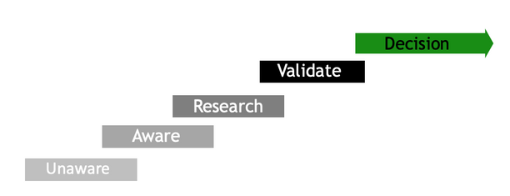
Commercial Excellence
HERE
@kateburda.com

Slide 6
Commercial Excellence
THE PROBLEM IS WHEN THE CUSTOMER IS AWARE OF THE PRODUCT THERE IS LITTLE THAT SALES AND MARKETING CAN DO TO ADD VALUE.
@kateburda.com

Slide 7
Commercial Excellence
WHY?
BECAUSE THE CUSTOMER HAS ALREADY STARTING TRYING TO FIGURE OUT WHAT MAKES SENSE FOR WHAT THEY ARE NEEDING.
@kateburda.com

Slide 8
Commercial Excellence
YOU ARE GETTING THERE TOO LATE IN THE JOURNEY YOU ARE DOING
EXACTLY
WHAT YOU DON’T WANT TO DO.
@kateburda.com

Slide 9

Commercial Excellence
BECOMING A
COMMODITY
SHAME ON YOU.
@kateburda.com

Slide 10
Commercial Excellence
SO LET’S
FLIP THE SCRIPT!
SALES AND MARKETING NEED TO CONNECT WITH THEIR CUSTOMERS EARLIER.
@kateburda.com

Slide 11

Commercial Excellence
THEY NEED TO SHOW UP WHEN THE CUSTOMER IS AWARE OF THE SITUATION
NOT WHEN THEY ARE AWARE OF THE PRODUCT
@kateburda.com

Slide 12
Commercial Excellence
TO SAVE CONFUSION...
LET’S CALL IT OUT.
BEING AWARE OF THEIR SITUATION AND AWARE OF YOUR PRODUCT ARE
TWO COMPLETELY DIFFERENT THINGS.
@kateburda.com

Slide 13
Commercial Excellence
CONNECTING WITH THE CUSTOMER WHEN THEY ARE AWARE OF THE SITUATION
IS CUSTOMER CENTRICITY.
@kateburda.com

Slide 14
Commercial Excellence
CONNECTING WITH THE CUSTOMER WHEN THEY ARE AWARE OF YOUR PRODUCT
IS ABOUT YOU MAKING THE SALE VS. ADDING VALUE
@kateburda.com

Slide 15
Commercial Excellence
CONNECT WITH US
TO UNDERSTAND HOW TO BRING YOUR COMMERCIAL TEAM TOGETHER TO CREATE IMPACT
@kateburda.com

